Slide 1
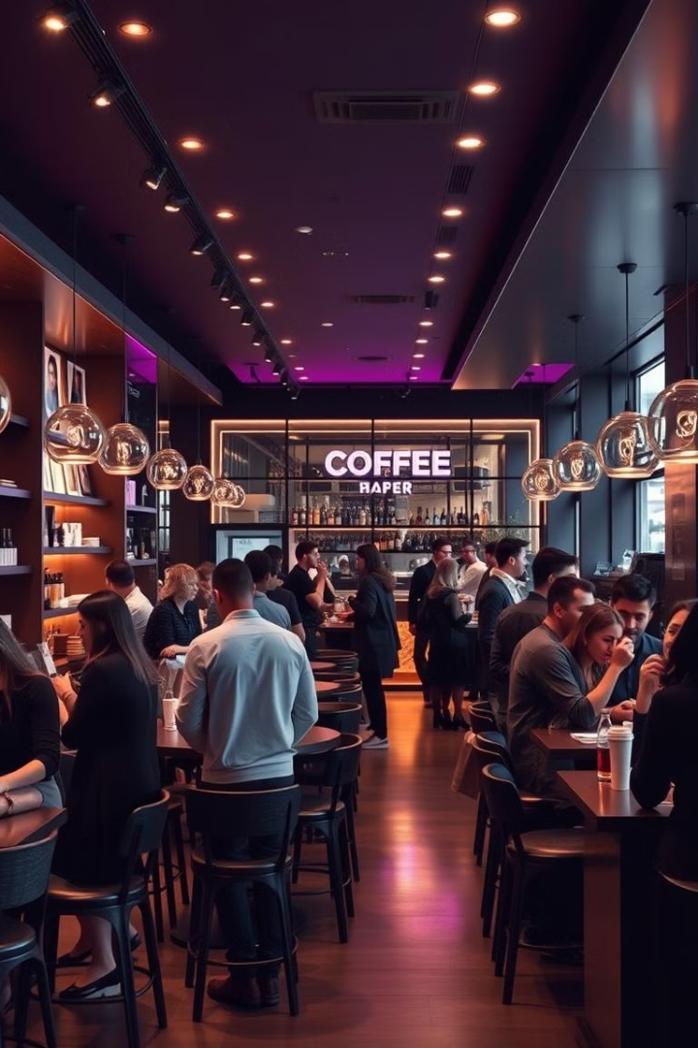
Coffee Shop Sales Analysis
Discover key findings and actionable recommendations to boost your retail performance. Our analysis reveals critical insights into customer preferences, purchasing patterns, and operational opportunities.
by Vicky Singh
VS

Slide 2
High-Demand Product Categories
Tea and Coffee
Targeted Promotions
Category Expansion
Consistently high sales volumes in these categories. Herbal tea, especially Coffee, is a top performer.
Run promotions for popular items like peppermint tea. Introduce seasonal flavors to maintain engagement.
Expand variety within high-performing categories. Add new herbal tea flavors to build on interest.

Slide 3



Customer Size Preferences
Identify Preference
Larger sizes generate higher sales revenue per transaction, especially for beverages like tea and coffee.
Upsell Strategy
Encourage upselling of larger sizes. Highlight cost savings per ounce or offer slight discounts.
Menu Optimization
Display "Large" size as default on menus and ordering screens. Create value-driven combo offers.

Slide 4
Peak Sales Hours
1
Identify Peak Times
High-traffic periods include mid-mornings (10-11 AM) and early afternoons. Although there is not much fluctuations in customers over the week.
2
Implement Happy Hours
Introduce "happy hour" promotions during slower times to spread foot traffic more evenly throughout day.
3
Optimize Staffing
Increase staffing and stock levels during peak hours. Reduce wait times and improve customer satisfaction.

Slide 5
Location-Based Sales Variation
Location
Performance
Strategy
Hell’s Kitchen
High
Stock popular items
Astoria
Medium
Balanced inventory
Lower Manhattan
Low
Limited-time offers

Slide 6



Popular Product Flavors
Highlight Top Flavors
Our Old Time Diner Blend , Ethiopia and Columbian Mediuam Roast are thre most popular flavors. Barista Espresso, Hot chocolate And Brewed Black tea is also most popular products.
Limited Editions
Introduce exclusive flavor options to create a sense of urgency and encourage repeat purchases.
Customization Options
Offer customizable drink options, allowing customers to create their perfect flavor combination.

Slide 7
Day and Time Impact
1
Weekdays Focus
2
Off-Peak Strategies
3
Time-Based Promotions
Transactions are significantly higher during weekdays. Capitalize on this with exclusive weekend deals.
Promote take-out orders or pre-ordering options for busier times. Reduce in-store congestion.
Implement time-specific offers to drive traffic during traditionally slower periods of the day.

Slide 8
RECOMMENDATIONS
Average Spending Patterns
Single-Item Purchase Patterns
1
Analyze Pricing Impact
Review how pricing affects transaction size and spending. Identify products yielding higher profitability.
Bundle Offers
Loyalty Incentives
Create deals pairing complementary items. Encourage multiple purchases per visit to increase transaction value.
Introduce rewards for purchasing multiple items. Offer bonus points for bundled purchases.
2
Strategic Adjustments
Regularly review and adjust pricing for popular items.
Ensure profitability while remaining competitive.
Promote High-Margin Items
Upsell Training
3
Focus promotional efforts on items with higher margins. Optimize revenue generation without increasing costs.
Train staff in effective upselling techniques. Suggest complementary items to single-item purchasers.

Slide 9




Implementation and Monitoring
Phased Roll-out
Implement recommendations gradually. Start with high-impact, low-effort changes for quick wins.
Data-Driven Decisions
Continue monitoring sales data. Use insights to refine strategies and make informed decisions.
Customer Feedback
Regularly collect and analyze customer feedback. Ensure changes positively impact customer experience.
Iterate and Improve
Continuously refine strategies based on performance data and customer responses. Stay agile and adaptive.

